Slide 1
Design Engineering
Dr.Sachin Bojewar

Slide 2
Design Engineering
It covers the set of principles, concepts, and practices that lead to the development of a high quality system or product.
Software design is a model of software which translates the requirements into finished software product in which the details about software data structure , architecture , interfaces and components that are necessary to implement the system are given

Slide 4
Software Design
Software design model consists of 4 design stages :
Data/class Design
Architectural Design
Interface Design
Component Design

Slide 5
Why design is so important?
It provides us with representation of software that can be assessed for quality.
Only way that can accurately translate a customer’s requirements into a finished software product.
Without design difficult to assess:
Risk
Test
Quality

Slide 6
Analysis Model
Object-oriented Analysis
Structured Analysis
Scenario-based
modeling
Flow-oriented
modeling
Use case text
Use case diagrams
Activity diagrams
Swim lane diagrams
Data flow diagrams
Class-based
modeling
Behavioral
modeling
Class diagrams
Analysis packages
Collaboration diagrams
State diagrams
Sequence diagrams

Slide 7
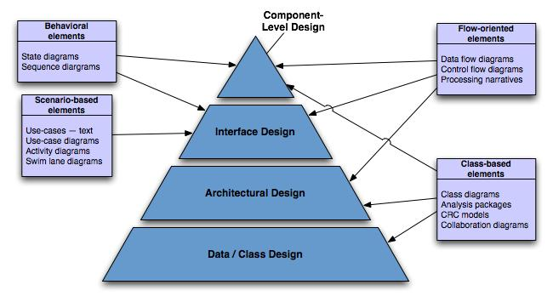
Translating Analysis → Design

Slide 8
Data/Class design –
Created by transforming the analysis model class-based elements into classes and data structures required to implement the software
Architectural design –
defines the relationships among the major structural elements of the software, it is derived from the class-based elements and flow-oriented elements of the analysis model

Slide 9
Interface design –
describes how the software elements, h\w elements, and end-users communicate with one another, it is derived from the analysis model scenario-based elements, flow-oriented elements, and behavioral elements
Component-level design –
created by transforming structural elements defined by the software architecture into a procedural description of the software components using information obtained from the analysis model class-based elements, flow-oriented elements, and behavioral elements

Slide 10
Design quality attributes
Functionality
Usability
Reliability
Performance
Supportability

Slide 11
Functionality – is assessed by evaluating the feature set.
Functions that are delivered and security of the overall system.
Usability – assessed by considering human factors, consistency & documentation.
Reliability – evaluated by
measuring the frequency of failure.
Accuracy of output results.
Ability to recover from failure and predictability of the program.
Performance - measured by processing speed, response time, resource consumption, efficiency.
Supportability – combines the ability to extend the program adaptability and serviceability.

Slide 12
Design concepts
Design concepts provide the necessary framework for “to get the thing on right way”.
Abstraction
Refinement
Modularity
Architecture
Information Hiding
Functional Independence
Cohesion
Coupling

Slide 13
Abstraction
At the highest level of abstraction – a solution is stated in broad terms
At lower level of abstraction – a more detailed description of the solution is provided.
Two types of abstraction:
Procedural abstraction: Sequence of instructions that have a specific and limited function.
Ex. Open a door
open implies long sequence of activities (e.g. walk to the door, hold knob, turn knob and pull the door, etc).
Data abstraction: collection of data that describes a data object.
Ex. Open a door. – door is data object.
Data abstraction for door would encompass a set of attributes that describe the door. (E.g. door type, swing direction, opening mechanism, etc.)

Slide 14
Refinement
Refinement is actually a process of elaboration.
begin with a statement of function or description of information that is defined at a high level of abstraction.
Refinement causes the designer to elaborate on the original statement, providing more and more detail as each successive refinement (elaboration) occurs.
Abstraction and refinement are complementary concepts. Abstraction enables a designer to specify procedure and data and yet suppress low-level details.
Refinement helps the designer to expose low-level details as design progresses.

Slide 15
Architecture
Software architecture suggest “ the overall structure of the software and the ways in which that structure provides conceptual integrity for a system.
Simply…architecture is the structure or organization of program components (modules), the manner in which these components interact, and the structure of data that are used by the components.

Slide 16
No. of different models can use to represent architecture.
Structural Model- represent architecture as an organized collection of components
Framework model – Increase level of design abstraction by identifying repeatable architectural design framework.
Dynamic model – address behavior of the program architecture
Process Model – focus on design of the technical process that the system must accommodate.
Functional models – used to represent the functional hierarchy of a system.

Slide 17
Modularity
Software is divided into separately named and addressable components, sometimes called modules, which are integrated to satisfy problem requirement.
modularity is the single attribute of software that allows a program to be intellectually manageable
It leads to a “divide and conquer” strategy. – it is easier to solve a complex problem when you break into a manageable pieces.
Refer fig. that state that effort (cost) to develop an individual software module does decrease if total number of modules increase.
However as the no. of modules grows, the effort (cost) associated with integrating the modules also grows.

Slide 18
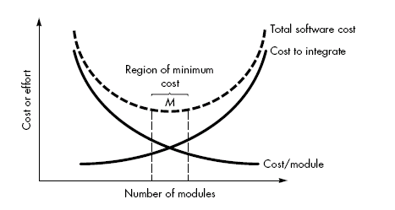
Modularity and software cost

Slide 19
Advantage of modularization:
Smaller components are easier to maintain
Program can be divided based on functional aspects
Desired level of abstraction can be brought in the program
Components with high cohesion can be re-used again
Concurrent execution can be made possible
Desired from security aspect

Slide 20
Information Hiding
The principle of information hiding suggests that modules be "characterized by design decisions that (each) hides from all others modules.“
In other words, modules should be specified and designed so that information (algorithm and data) contained within a module is inaccessible to other modules that have no need for such information.
The intent of information hiding is to hide the details of data structure and procedural processing behind a module interface.
It gives benefits when modifications are required during testing and maintenance because data and procedure are hiding from other parts of software, unintentional errors introduced during modification are less.

Slide 21
Functional Independence
Each module addresses a specific sub-function of requirements and has a simple interface when viewed from other parts of the program structure.
Independence is important –
Easier to develop
Easier to Test and maintain
Error propagation is reduced
Reusable module.

Slide 22
Functional Independence
To summarize, functional independence is a key to good design, and design is the key to software quality.
To measure independence, have two qualitative criteria: cohesion and coupling
Cohesion is a measure of the relative functional strength of a module.
Coupling is a measure of the relative interdependence among modules.

Slide 23
Cohesion
Cohesion is a natural extension of the information hiding concept
Cohesion is a measure that defines the degree of intra-dependability within elements of a module.
The greater the cohesion, the better is the program design.
A cohesive module performs a single task within a software procedure, requiring little interaction with procedures being performed in other parts of a program

Slide 24
Types of cohesion
There are basically 7 types of cohesion
Co-incidental cohesion - It is unplanned and random cohesion, which might be the result of breaking the program into smaller modules for the sake of modularization. Because it is unplanned, it may serve confusion to the programmers and is generally not-accepted.
Logical cohesion - When logically categorized elements are put together into a module, it is called logical cohesion.

Slide 25
Types of cohesion
temporal Cohesion - When elements of module are organized such that they are processed at a similar point in time, it is called temporal cohesion.
Procedural cohesion - When elements of module are grouped together, which are executed sequentially in order to perform a task, it is called procedural cohesion.
Communicational cohesion - When elements of module are grouped together, which are executed sequentially and work on same data (information), it is called communicational cohesion.

Slide 26
Types of cohesion
Sequential cohesion - When elements of module are grouped because the output of one element serves as input to another and so on, it is called sequential cohesion.
Functional cohesion - It is considered to be the highest degree of cohesion, and it is highly expected. Elements of module in functional cohesion are grouped because they all contribute to a single well-defined function. It can also be reused.

Slide 27
Coupling
Coupling is a measure that defines the level of inter dependability among modules of a program.
It tells at what level the modules interfere and interact with each other.
The lower the coupling, the better the program.
Coupling depends on the interface complexity between modules, the point at which entry or reference is made to a module, and what data pass across the interface

Slide 28
Levels of coupling
There are five levels of coupling, namely -
Content coupling - When a module can directly access or modify or refer to the content of another module, it is called content level coupling.
Common coupling- When multiple modules have read and write access to some global data, it is called common or global coupling.
Control coupling- Two modules are called control-coupled if one of them decides the function of the other module or changes its flow of execution.

Slide 29
Levels of coupling
Stamp coupling- When multiple modules share common data structure and work on different part of it, it is called stamp coupling.
Data coupling- Data coupling is when two modules interact with each other by means of passing data (as parameter). If a module passes data structure as parameter, then the receiving module should use all its components.
Ideally, no coupling is considered to be the best.

Slide 30
Design model
The design model can be viewed in two different dimensions
The process dimension indicates the evolution of the design model as design tasks are executed as part of the software process.
The abstraction dimension represents the level of detail as each element of the analysis model is transformed into a design equivalent and then refined iteratively.
The elements of the design model use many of the same UML diagrams that were used in the analysis model.
The difference is that these diagrams are refined and elaborated as part of design; more implementation-specific detail is provided,

Slide 31
Data Design Element
Represents the high level of abstraction.
The data represented at this level is refined gradually for implementing the computer based system.
Data has great impact on architecture of s/w system …Hence structure of data is very important factor in s/w design
Data appears in the form of data structures and algorithms at program component level.
At application level the database and at business level it appears a s data warehouse and data mining
Therefore data plays important role in s/w design

Slide 32
Architecture Design Element
This gives the layout for overall view of s/w
This can be build using
Dataflow models / class diagrams
Information obtained form application domain
Architectural patterns and styles

Slide 33
Interface design elements
This represents detailed design of s/w system
Interface design shows how information flow form one component to another in system
There are three important elements of interface design:
(1) the user interface (UI);
(2) external interfaces to other systems, devices, networks
(3) internal interfaces represents inter component communication of system eg- two classes communicate with each other by passing messages

Slide 34
Component level design elements
It shows more detailed design of s/w system along with specification
It describes internal details of components
In this all local data objects , required data structures and algorithmic details and procedural details are exposed

Slide 35
Deployment level design elements
This indicates how s/w functions and s/w subsystems are assigned to physical computing environment of s/w product

